Slide 1
Session 4 White-Box Testing (2)
chengbaolei@suda.edu.cn

Slide 2
Objectives
Review of Session 3
Basic Concepts of White box testing
Logic Coverage
Control Flow Graph
Basis Path Testing
Loop Testing
Data Flow Testing

Slide 3
3.1 Basic Concepts
White-box testing must follow several principles:
All independent path in a module must be implemented at least once. (Basis path testing)
All logic values require two test cases: true and false. (Logic coverage)
Inspection procedures of internal data structure, and ensuring the effectiveness of its structure.
(Static Testing + Data Flow Testing)
Run all cycles within operational range.
(Loop testing)

Slide 4
3.2 Logic Coverage
Logic coverage
Statement Coverage
Decision Coverage
Condition Coverage
Condition/Decision Coverage
Modified Condition/Decision Coverage
Condition Combination Coverage
Path Coverage
Complete Coverage
Notes:
4
逻辑覆盖是通过对程序逻辑结构的遍历实现程序的覆盖。

Slide 5
Exercise 5
Design test cases for the following flowchart to satisfy 8 types of coverage。(Note: X and Y are signed integers or 0)
N
X>8 AND Y>5
Y
X>0 OR Y>0
X>16 OR Y>10
N
Y
N
Y
S3
S1
S2

Slide 6
Exercise 6
Try to analyze the relationship among 8 different coverage strategies
Statement Coverage
Decision Coverage
Condition Coverage
Condition/Decision Coverage
Modified Condition/Decision Coverage
Condition Combination Coverage
Path Coverage
Complete Coverage

Slide 7
Exercise 6
Complete Coverage
Path Coverage
∪
Condition Combination Coverage
Modified Condition-Decision Coverage
Condition-Decision Coverage
Condition Coverage
∪
Decision Coverage
Statement Coverage

Slide 8
Objectives
In session 4, you will learn
Basic Concepts of White box testing
Logic Coverage
Control Flow Graph
Basis Path Testing
Loop Testing
Data Flow Testing

Slide 9
3.3 Control Flow Graph
Concept
During procedure design , in order to more prominent the control flow structure, the procedure can be simplified, the simplified graph is called control flow graph. (vs. program flow graph)
On a flow graph:
Arrows called edges represent flow of control.
Circles called nodes represent one or more actions.
Areas bounded by edges and nodes called regions.
A predicate node is a node containing a condition.

Slide 10
3.3 Control Flow Graph
Common control flow graph
Order statement
While statement
Until statement
…
IF statement
Case statement

Slide 11
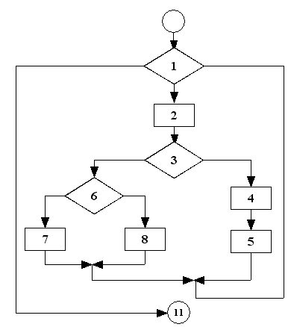
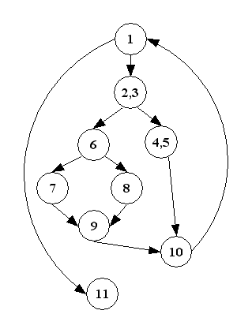
3.3 Control Flow Graph
Change a program flow chart into a control flow graph
（a）program flow chart
（b）control flow graph

Slide 12
Exercise 1
Draw the control flow graph of the program fragment below
void DoWork(int x, int y, int z)
{
1 int k=0,j=0;
2 if ((x>3)&&(z<10))
3 {
4 k=k*y-1;
5 j=sqrt(k);
6 }
7 if ((x==4)‖(y>5))
8 j=x*y+10;
9 j=j%3;
10 }

Slide 13
Exercise 1
Answer
Control flow graph
1,2
T
3,4,5,6
F
7
T
F
8
9,10

Slide 14
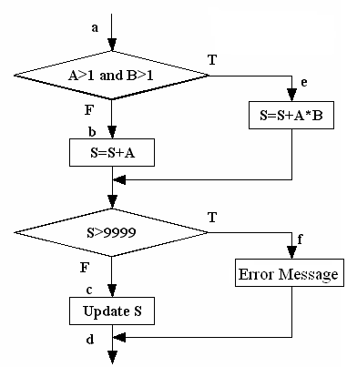
Exercise 2
Requirement
Draw control flow graph
Use 8 types of logic coverage to design test case.

Slide 15
Exercise 2
No. | Coverage type | Test case | Expected output
1 | Statement coverage | A＝2，B＝2，S＝9999 | Error Message
2 |  | A＝1，B＝1，S＝9997 | Update S
3 | Decision coverage | A＝2，B＝2，S＝9999 (TT) | Error Message
4 |  | A＝1，B＝1，S＝9997(FF) | Update S
5 | Condition combination coverage | A＝2，B＝2，S＝9997 | Error Message
6 |  | A＝1，B＝2，S＝9999 | Error Message
7 |  | A＝1，B＝1，S＝9997 | Update S
8 |  | A＝2，B＝1，S＝9997 | Update S
… | … | … | …
1
2
3
4
5
6
7

Slide 16
3.3 Control Flow Graph
Control flow graph of conditions decomposition
A>1 and B=0
T
1
A>1 and B=0
T
2
X=X/A
F
F
X=X/A
3
EndIF
（2）corresponding control flow graph to program flow chart（1）
（1）Program flow chart
A>1
1
T
B=0
T
T
A>1
B=0
F
2
X=X/A
F
F
T
F
X=X/A
EndIF
4
3
（3）Detailed program flow chart
（4）corresponding control flow graph to program flow chart（3）

Slide 17
Exercise 2-continued
Draw control flow graph of conditions decomposition
1
3
1
2
4
2
3
5
4
6
7
5
6
8
7

Slide 18
Exercise 3
void test(int iStudents, int iData[ ]) 0 { 1 int x=0; 2 int y=0; 3 int z=0; 4 for(int loop=0; loop< iStudents;loop++) 5 { 6 int dNum= iData[loop]; 7 if(dNum<60) 8 x++; 9 else 10 { 11 if(dNum>=60) 12 y++; 13 else 14 z++; 15 } 16 } 17 }

Slide 19
Exercise 3
0-3
4
5-7
9-11
8
12
13-14
15
17
16

Slide 20
3.4 Basis Path Testing
A testing mechanism proposed by McCabe.
This method generates a set of linearly independent paths, which we called basis paths, from Control Flow Graph (CFG) and all the other paths can be expressed by them.

Slide 21
3.4 Basis Path Testing
Why we need basis path testing?
Exhaustive path testing is usually impossible.
Aim is to derive a logical complexity measure of a procedural design and use this as a guide for defining a basic set of execution paths.
Test cases which exercise basic set will execute every statement at least once.

Slide 22
3.4 Basis Path Testing
Basis path testing is a hybrid between path testing and branch testing:
Path Testing: Testing designed to execute all or selected paths through a program.
Branch Testing: Testing designed to execute each outcome of each decision point in a program.
Basis Path Testing: Testing that fulfills the requirements of branch testing & also tests all of the independent paths that could be used to construct any arbitrary path through the program.

Slide 23
3.4 Basis Path Testing
How to design test cases for basis path testing
Using the design or code, draw the corresponding control flow graph.
Determine the cyclomatic complexity of the flow graph.
Determine a basis set of independent paths.
Prepare test cases that will force execution of each path in the basis set.

Slide 24
3.4 Basis Path Testing
Cyclomatic Complexity （环路复杂度/圈复杂度）
It gives a quantitative measure of the logical complexity.
This value gives the number of independent paths in the basis set, and an upper bound for the number of tests to ensure that each statement and both sides of every decision/condition is executed at least once.
An independent path is any path through a program that introduces at least one new set of processing statements (i.e., a new node) or a new condition (i.e., a new edge)

Slide 25
3.4 Basis Path Testing
Cyclomatic Complexity
#Edges - #Nodes + 2
#Predicate Nodes + 1
# closed regions + 1

Slide 26
3.4 Basis Path Testing
1
1
3
2
3
2
4
4
5
5
6
6
7
7
8
Different Cyclomatic Complexity
Statement coverage
Decision coverage / Condition coverage

Slide 27
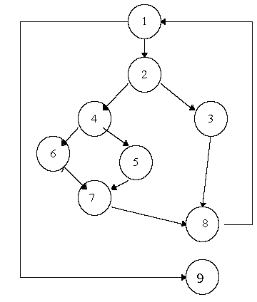
3.4 Basis Path Testing
Begin at the module's entry point, take the leftmost path through the module to its exit. Return to the beginning and vary the branching condition.
Like depth-first searching.
Independent Paths:
P1: 1, 9
P2: 1, 2, 4, 6, 7, 8, 1, 9
P3: 1, 2, 4, 5, 7, 8, 1, 9
P4: 1, 2, 3, 8, 1, 9

Slide 28
3.4 Basis Path Testing
Summary
Using the design or code, draw the corresponding flow graph.
Determine the cyclomatic complexity of the flow graph.
Determine a basis set of independent paths.
Prepare test cases that will force execution of each path in the basis set.

Slide 29
Exercise 3
void test(int iStudents, int iData[ ]) 0 { 1 int x=0; 2 int y=0; 3 int z=0; 4 for(int loop=0; loop< iStudents; loop++) 5 { 6 int dNum= iData[loop]; 7 if(dNum<60) 8 x++; 9 else 10 { 11 if(dNum>=60) 12 y++; 13 else 14 z++; 15 } 16 } 17 }

Slide 30
Requirements
Draw the control flow graph.
Calculate the cyclomatic complexity.
Derive the basis set of independent paths.
Design the test cases.

Slide 31
Exercise 3
0-3
4
5-7
9-11
8
12
13-14
15
17
16

Slide 32
Exercise 3
0-3
Cyclomatic complexity
3+1=4
3-4-17
3-4-7-8-16-4-17
3-4-7-11-12-15-16-4-17
3-4-7-11-14-15-16-4-17
4
5-7
9-11
8
12
13-14
15
17
16

Slide 33
Exercise 3
Path | Input int iStudents, int iData[ ]
3-4-17 | -1，[2,3]
3-4-7-8-16-4-17 | 3, [30,40,50]
3-4-7-11-12-15-16-4-17 | 3, [80,82,85]
3-4-7-11-14-15-16-4-17 | Null
Dead code / Infeasible path

Slide 34
Exercise 4
i=1,n1=n2=0,sum=0
Inputs: Score[i]
Outputs: n2, sum, average
No conditions decomposition
Conditions decomposition
F
Score[i]≠-1 and n2<50
T
n2=n2+1
F
Score [i]>0 and Score [i]<100
T
n1=n1+1,sum=sum+ Score [i]
i=i+1
F
n1>0
T
average=-1
average=sum/n1
Notes:
-1

Slide 35
Exercise 4-- Answer 1
1
i=1,n1=n2=0,sum=0
1
2
Score[i]≠-1 and n2<50
2
3
n2=n2+1
3
4
Score [i]>0 and Score [i]<100
4
5
5
n1=n1+1,sum=sum+ Score [i]
6
i=i+1
6
7
7
8
n1>0
9
average=-1
average=sum/n1
8
9
10
10

Slide 36
Exercise 4
For Answer 1, derive the basis paths：
Path 1：1-2-7-8-10
Path 2：1-2-7-9-10
Path 3：1-2-3-4-6-2-7-8-10
Path 4：1-2-3-4-5-6-2-7-9-10

Slide 37
Exercise 4-- Answer 2
1
i=0,n1=n2=0,sum=0
1
2
3
Score[i]≠-1 and n2<50
2
F
T
4
n2=n2+1
3
5
6
9
F
T
Score [i]>0 and Score [i]<100
4
10
11
7
n1=n1+1,sum=sum+ Score [i]
i=i+1
12
5
8
T
9
F
6
T
10
n1>0
11
F
7
average=-1
average=sum/n1
12
8

Slide 38
Exercise 4
For Answer 2, derive the basis paths：
Path 1：1-2-9-10-12
Path 2：1-2-9-11-12
Path 3：1-2-3-9-10-12
Path 4：1-2-3-4-5-8-2-9-10-12
Path 5：1-2-3-4-5-6-8-2-9-10-12
Path 6：1-2-3-4-5-6-7-8-2-9-11-12

Slide 39
Exercise 3/4
Design test cases.

Slide 40
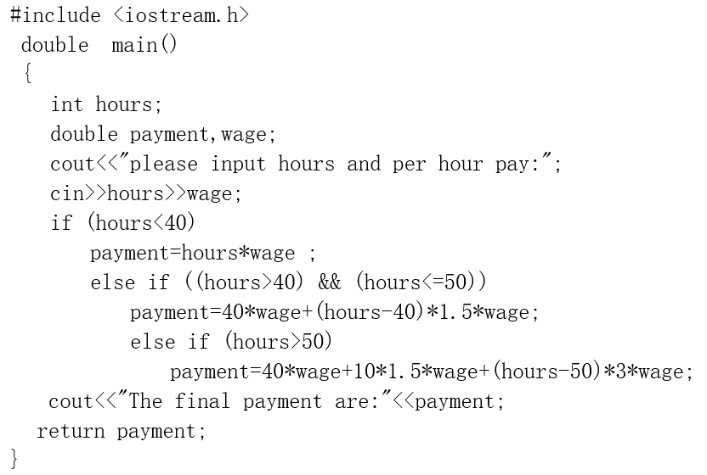
QUIZ-1 Logic Coverage

Slide 41
QUIZ-2 Basis Path Testing
void insertionSort(int numbers[ ], int array_size)
0{
1 int i, j, index;
2 for (i=1; i < array_size; i++)
3 {
4 index = numbers[i];
5 j = i;
6 while ((j > 0) && (numbers[j-1] > index))
7 { numbers[j] = numbers[j-1];
8 j = j - 1;
9 }
10 numbers[j] = index;
11 }
12}

Slide 42
Objectives
In session 3-4, you have learned
Basic Concepts of White box testing
Logic Coverage
Control Flow Graph
Basis Path Testing
Loop Testing
Data Flow Testing

